Slide 1

Your personal finance app by college students, for college students
Notes:
BLAKE

Slide 2



[m.]
Managing Money
Saving Money
Financial Literacy
Notes:
BLAKE

Slide 3
Problem.
College students are frustrated with managing and saving their money because they lack access to financial literacy tools to prepare them for their life in college and beyond.
Notes:
BLAKE

Slide 4
Notes:
BLAKE

Slide 5

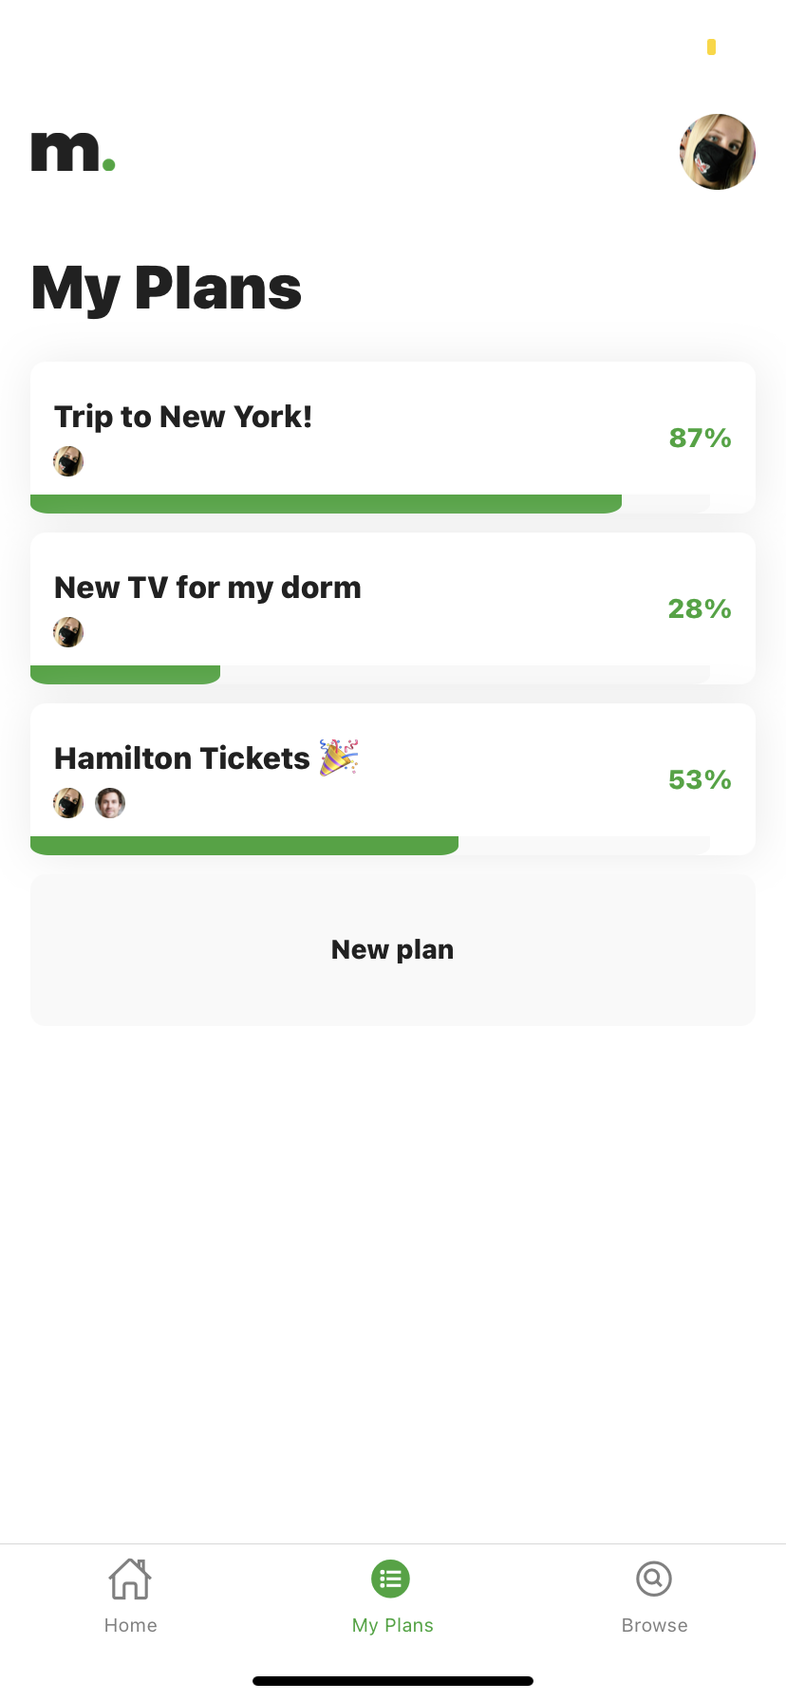


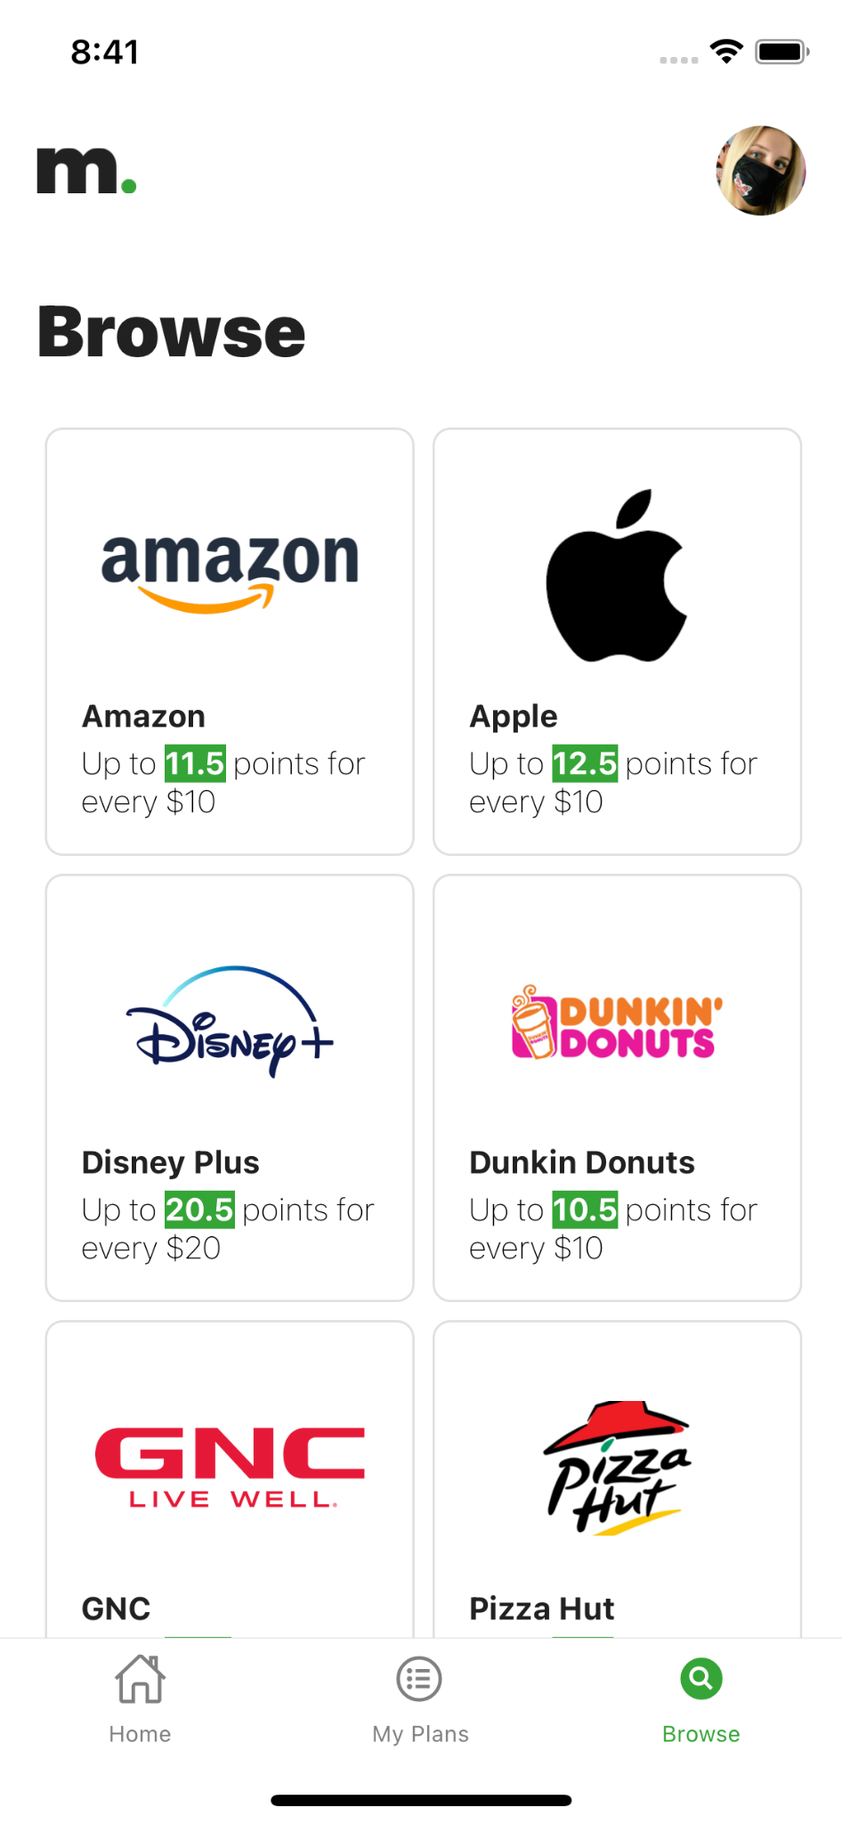
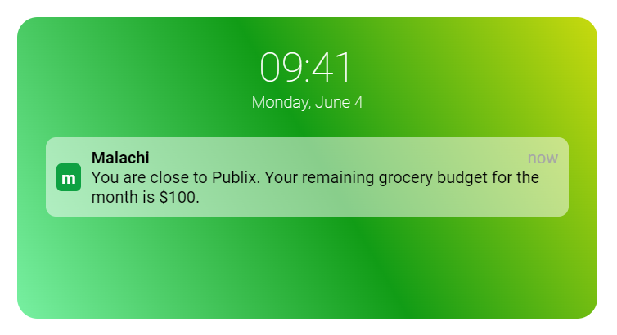
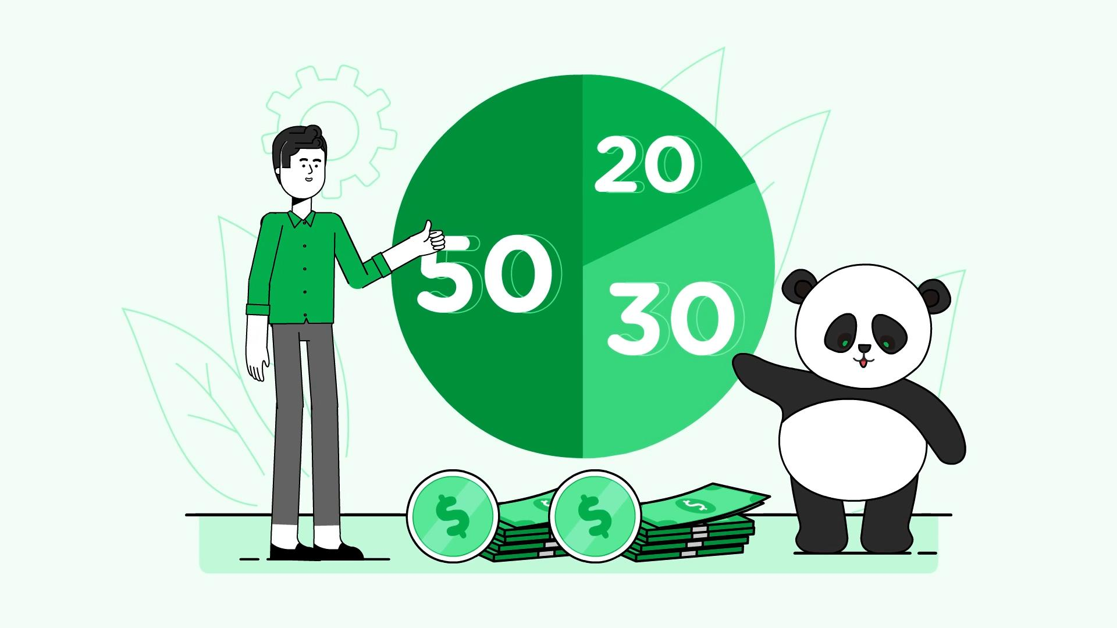

Features.
Savings Plans
Rewards Program
Personalized Budgets
Learning Modules
Notes:
BLAKE
We accomplish this through 4 main features: [list features]
We allow users to create savings plans for major expenditures, set budgets and receive notifications when arriving at a location that may affect their budget, complete learning modules that use examples from their finances in a digestible video format
All of these features provide the users with points when they complete a savings plan, stay on budget, or complete a learning module. Additionally, users can also earn points by shopping at affiliated retailers through our key partner Kard which we will discuss later. All of these points can be redeemed for rewards such as gift cards.

Slide 6
SAVE FOR LARGE PURCHASES
CREATE PLANS WITH YOUR FRIENDS
EARN REWARD POINTS
Notes:
BLAKE
We accomplish this through 4 main features: [list features]
We allow users to create savings plans for major expenditures, set budgets and receive notifications when arriving at a location that may affect their budget, complete learning modules that use examples from their finances in a digestible video format
All of these features provide the users with points when they complete a savings plan, stay on budget, or complete a learning module. Additionally, users can also earn points by shopping at affiliated retailers through our key partner Kard which we will discuss later. All of these points can be redeemed for rewards such as gift cards.

Slide 7
GEO-FENCED NOTIFICATIONS
CUSTOM BUDGETING
IMPROVE MONEY MANAGEMENT
Notes:
BLAKE
We accomplish this through 4 main features: [list features]
We allow users to create savings plans for major expenditures, set budgets and receive notifications when arriving at a location that may affect their budget, complete learning modules that use examples from their finances in a digestible video format
All of these features provide the users with points when they complete a savings plan, stay on budget, or complete a learning module. Additionally, users can also earn points by shopping at affiliated retailers through our key partner Kard which we will discuss later. All of these points can be redeemed for rewards such as gift cards.

Slide 8
INTERACTIVE FINANCE VIDEOS
CUSTOMIZED FROM YOUR FINANCIAL DATA
EXPAND YOUR FINANCIAL LITERACY
Notes:
BLAKE
We accomplish this through 4 main features: [list features]
We allow users to create savings plans for major expenditures, set budgets and receive notifications when arriving at a location that may affect their budget, complete learning modules that use examples from their finances in a digestible video format
All of these features provide the users with points when they complete a savings plan, stay on budget, or complete a learning module. Additionally, users can also earn points by shopping at affiliated retailers through our key partner Kard which we will discuss later. All of these points can be redeemed for rewards such as gift cards.

Slide 9
RECEIVE POINTS FOR COMPLETING TASKS
EARN POINTS SHOPPING AT AFFILIATES
REDEEM POINTS FOR GIFT CARDS
Notes:
BLAKE
We accomplish this through 4 main features: [list features]
We allow users to create savings plans for major expenditures, set budgets and receive notifications when arriving at a location that may affect their budget, complete learning modules that use examples from their finances in a digestible video format
All of these features provide the users with points when they complete a savings plan, stay on budget, or complete a learning module. Additionally, users can also earn points by shopping at affiliated retailers through our key partner Kard which we will discuss later. All of these points can be redeemed for rewards such as gift cards.

Slide 10
Notes:
BLAKE

Slide 11
Your personal finance app by college students, for college students
Notes:
BLAKE

